Slide 1
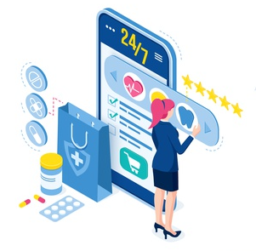
Mini Project Presentation
Better You – A Medical Store Website
Submitted To: Akash Kumar Chaudhary
Submitted By: Nidhi Jain (181500423)
Radhika Bansal (181500528)

Slide 2
BetterYou
“The best and most efficient pharmacy is within your own system”
The name of this website, ‘BetterYou’ itself depicts its true meaning of concerning about your health in all extent which will enhance your immune system as well as your desire to look after yourself in a better way.
We are creating “A real-time website to shop medicines online.” In this, we will provide the functionality to buy the medicines or pharmaceuticals from their home comfort efficiently.

Slide 3
Our Idea
In today’s era, we all are aware of our daily changing requirements and the need to shop as in the world of digital marketing.
Shopping the daily needs virtually is what when individuals interact without being face-to-face but through words and texts they sent or receive data to be shared. We can share information and the need can be delivered to us.
The “Online Medical Store” has been developed to override the prevailing problems in the practicing manual system. This software is supported to eliminate and in some cases reduce the hardships faced by this existing system.

Slide 4
It is a virtual showcase for different types of medicine like health care, baby care, & home need products. Main aim of this project is to develop 24/7 medical service for users through online application.
It provides a user-friendly interface with various categories of health products.
The website includes all the major categories of health care and personal care products.
It provides all the information about the medicines we have included in our website.
It includes the different modules to enhance the functionality.
The main categories are sub-categorized which results in an effective way to find the products that user need.
What Our Website include?

Slide 5
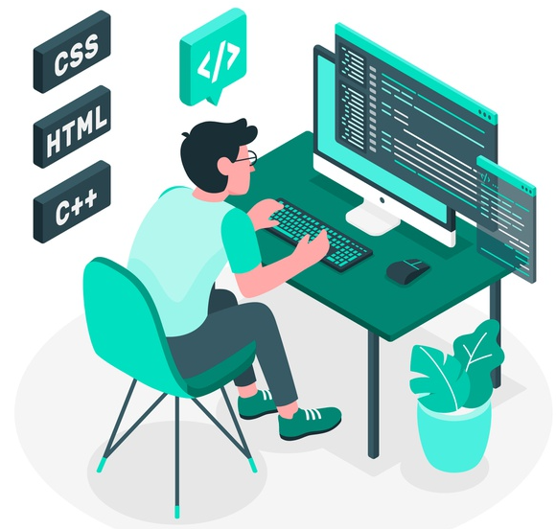
Technologies Used
Online Medical Store is a website, it uses full stack technologies. We will design the front-end i.e. user interface of the website.
The main technologies used are:
Visual Studio Code Editor
HTML
CSS/Bootstrap
JavaScript/JQuery
UIPath

Slide 6

Visual Studio Code
Visual Studio Code is a code editor redefined and optimized for building and debugging modern web and cloud applications.
Visual Studio Code is a freeware source-code editor made by Microsoft for Windows, Linux and macOS. Features include support for debugging, syntax highlighting, intelligent code completion, snippets, code refactoring, and embedded Git.
The true power of Visual Studio Code is its extensions: theme extensions add colors and icons, language extensions enable smart code completion (IntelliSense) and navigation, debugger extensions enable you to run your code and easily find bugs.

Slide 7

HTML
HTML stands for Hypertext Markup Language where Hypertext refers to the way in which Web pages (HTML documents) are linked together. Thus, the link available on a webpage is called Hypertext.
Page layout has been designed with HTML. It is used for making the structure to the website.
HTML was developed with the intent of defining the structure of documents like headings, paragraphs, lists, and so forth to facilitate the sharing of scientific information between researchers.
It is platform independent. Images, video and audio can be added to a web page.

Slide 8


CSS/Bootstrap
CSS stands for Cascading Style Sheets. It is used to design the elements or structure made with the help of HTML.
It is used to provide the better User Interface to the website and eye-catchy look. This style sheet language also allows you to add effects or animations to your website. Without CSS, your website will appear as a plain HTML page.
Bootstrap is a front-end framework for faster and easier web development. Bootstrap is a free and open-source tool collection for creating responsive websites and web applications.
Bootstrap is a CSS framework which helps in reducing the work with CSS which result in compact code and time saving.

Slide 9


JavaScript/JQuery
JavaScript is used to provide the interactivity among the different modules of the website with dynamic features. All the validations in the login or signup form are done by JS.
JavaScript is high-level, dynamic and browser interpreted programming language, supported by all modern web browsers. JavaScript is also being used widely in game development and Mobile application development.
JQuery is a fast, small, and feature-rich JavaScript library. It makes things like HTML document traversal and manipulation, event handling, animation, and Ajax much simpler with an easy-to-use API that works across a multitude of browsers.
With a combination of versatility and extensibility, JQuery has changed the way that millions of people write JavaScript.

Slide 10

UI PATH
UiPath is a robotic process automation platform for end-to-end high-scale automation. UiPath software offers solutions for enterprises to automate repetitive office tasks for rapid business transformation. It converts boring tasks into automation process using multiple tools.
We use UIPath for webscrapping, which is a technique of automatically logging in to a website, extracting data that spans multiple webpages, and filtering and transforming it into the format of your choice before integrating it into another application or web service.

Slide 11
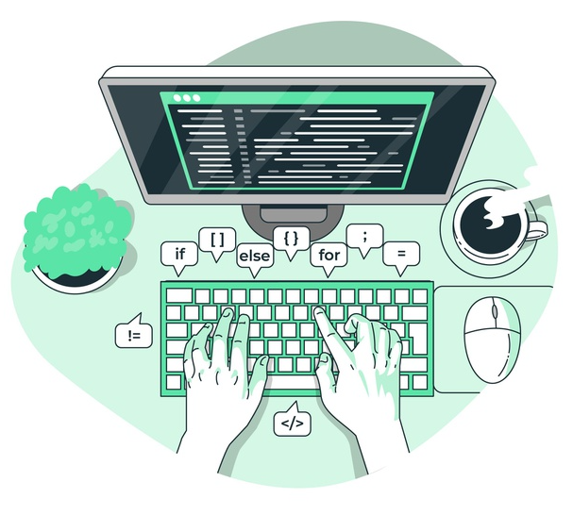
User Interface Implementations

Slide 12
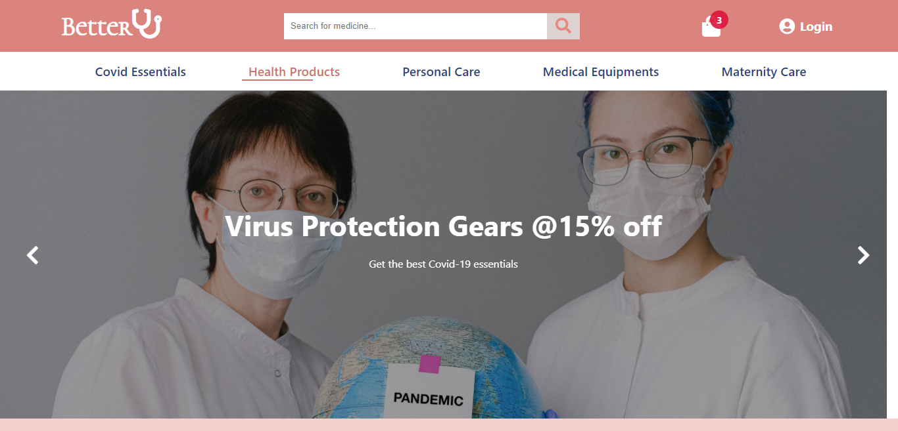
Landing Page
This is the first view at the opening of our website showing the navigation bar with various health category options below and a banner.

Slide 13
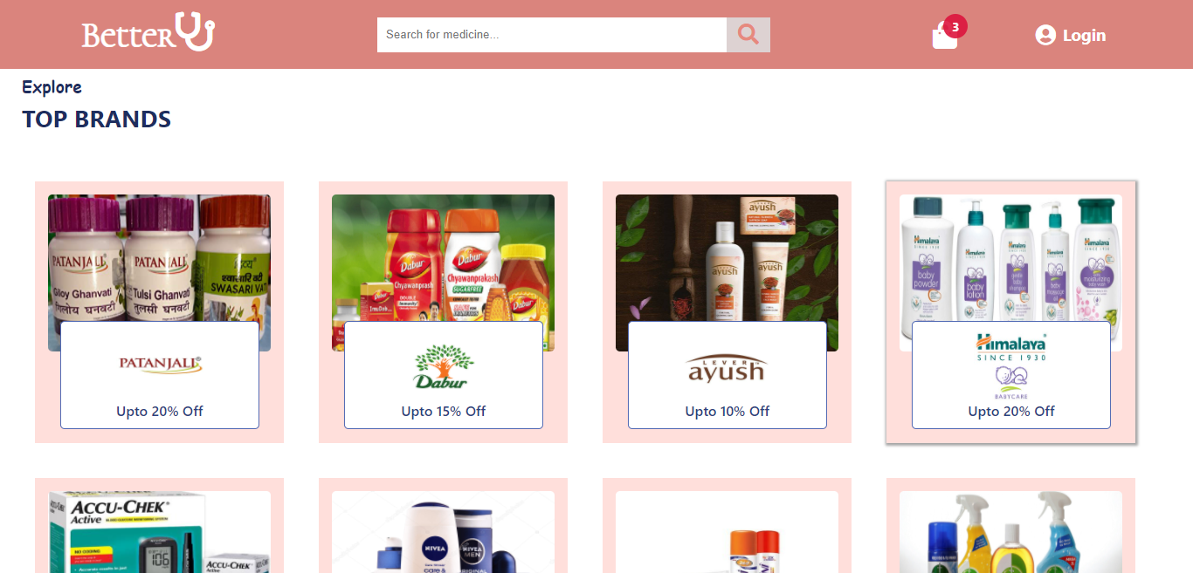
Top Brands Section
This section shows the popular brands whose products are delivered to you. It includes all the main categorized types for health purpose.

Slide 14
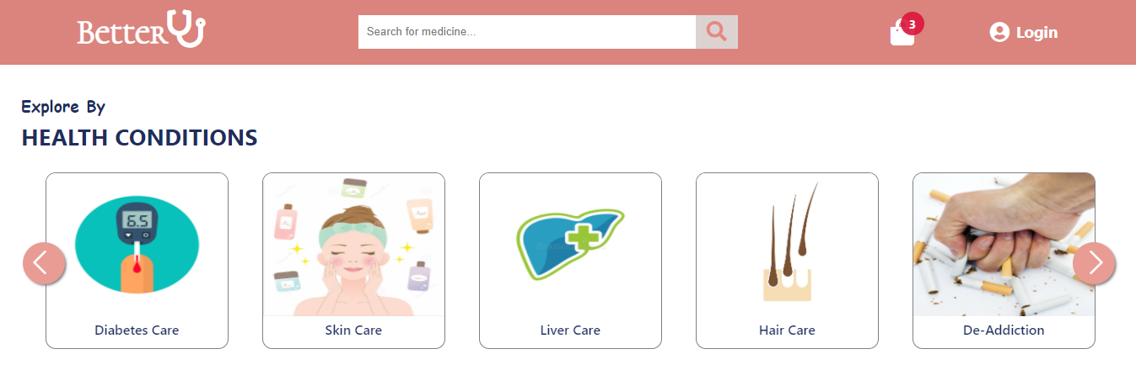
Health Category Section
This section categorizes the products according to the health conditions of the people like diabetic care, stomach ache, liver pain, de-addiction, hair care, skin care, etc.

Slide 15
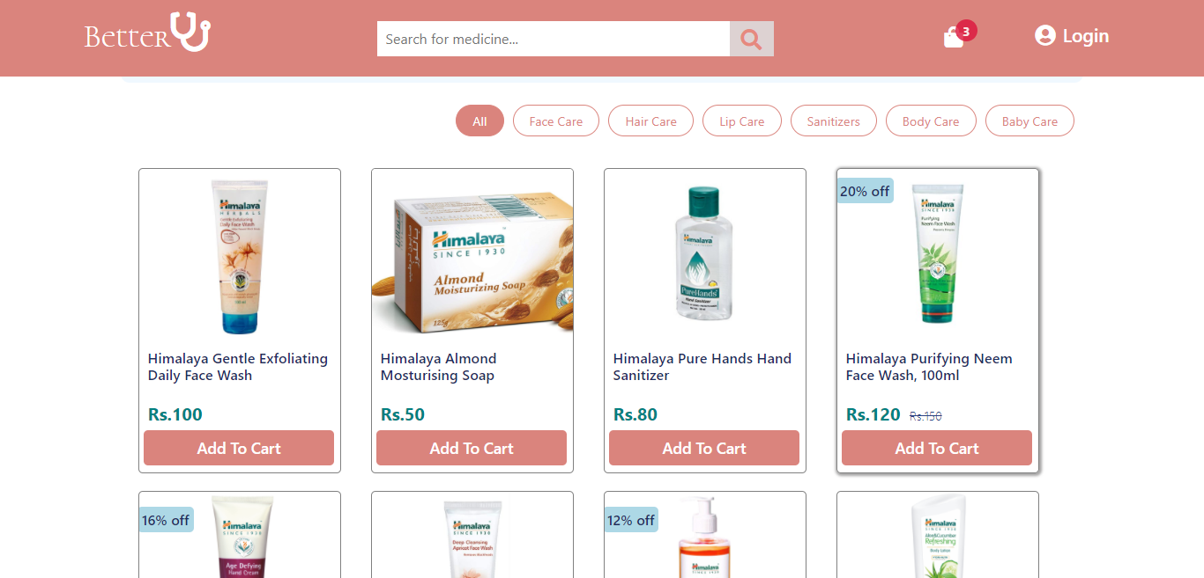
Brand Product Page
This page shows the products of a single category you choose from main page with further categories like Hair Care, Body Care, FaceWash, Baby Care, etc i.e. a filter is given so that person can sort the products according to their needs.

Slide 16
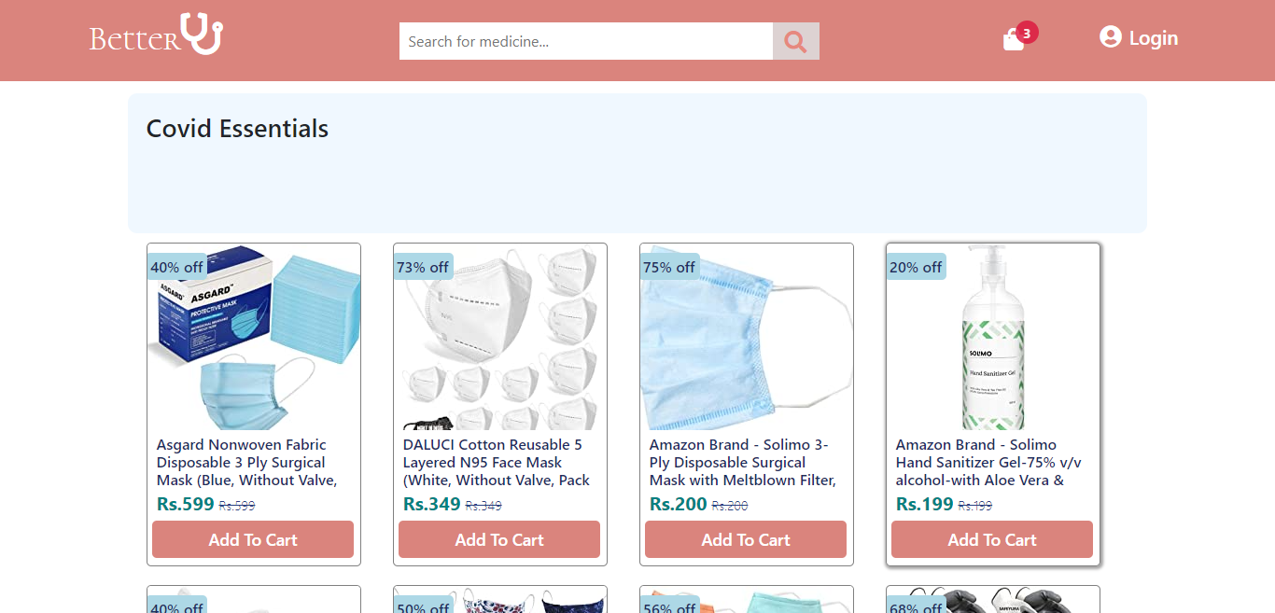
Popular Categories Page
This page reveal all the products related to the category shown in main page slider. All these products are fetched using “WEBSCRAPPING” with a tool named “UIPath” so that the products are added into this page dynamically after making the product description file.

Slide 17
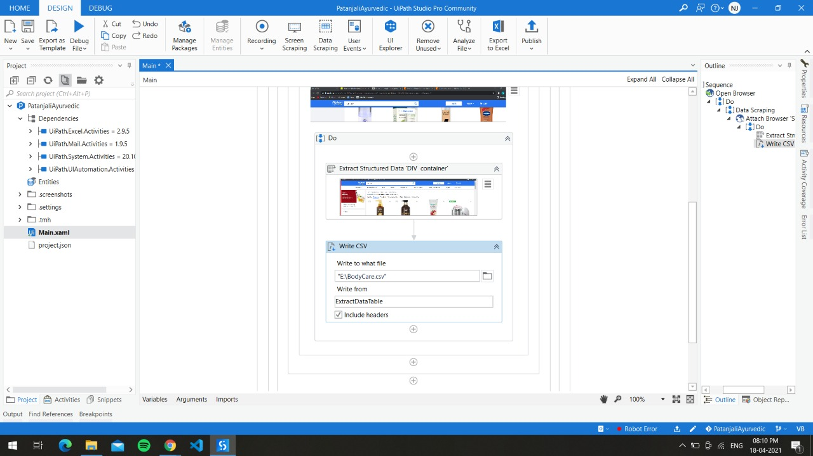
Webscrapping
It is a process of using bots to extract content and data from a website. Unlike screen scraping, it extracts underlying HTML code and with it data is stored in a database.

Slide 18
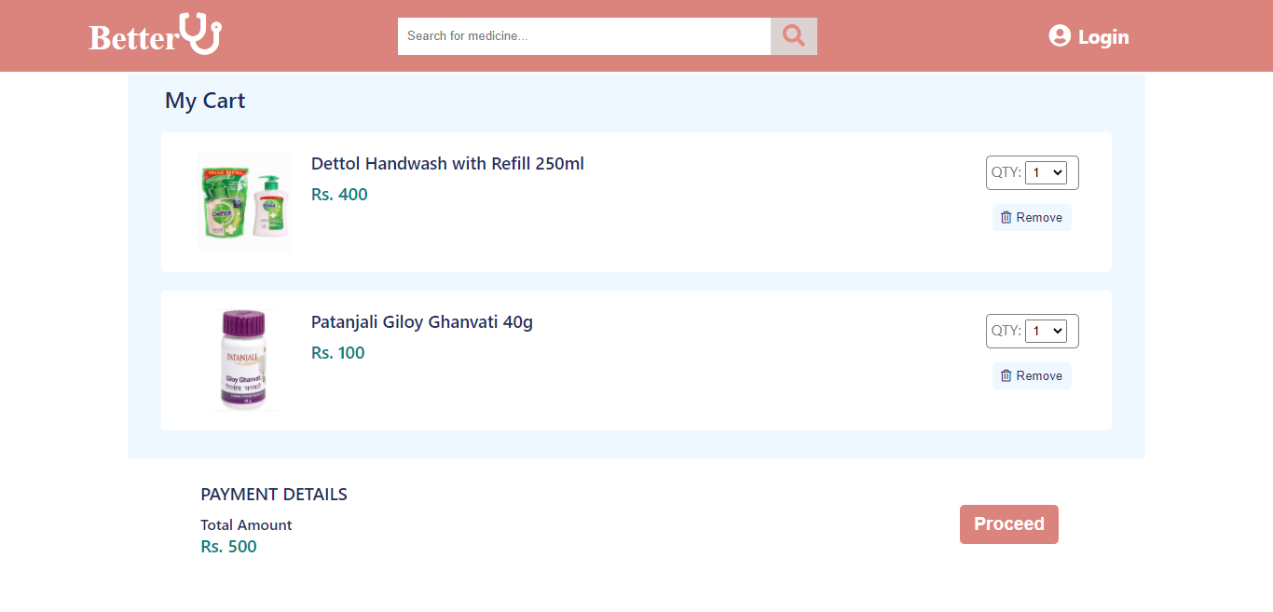
Add to Cart UI
This page has the functionality of adding the products user wants to purchase in their cart for further formalities.

Slide 19
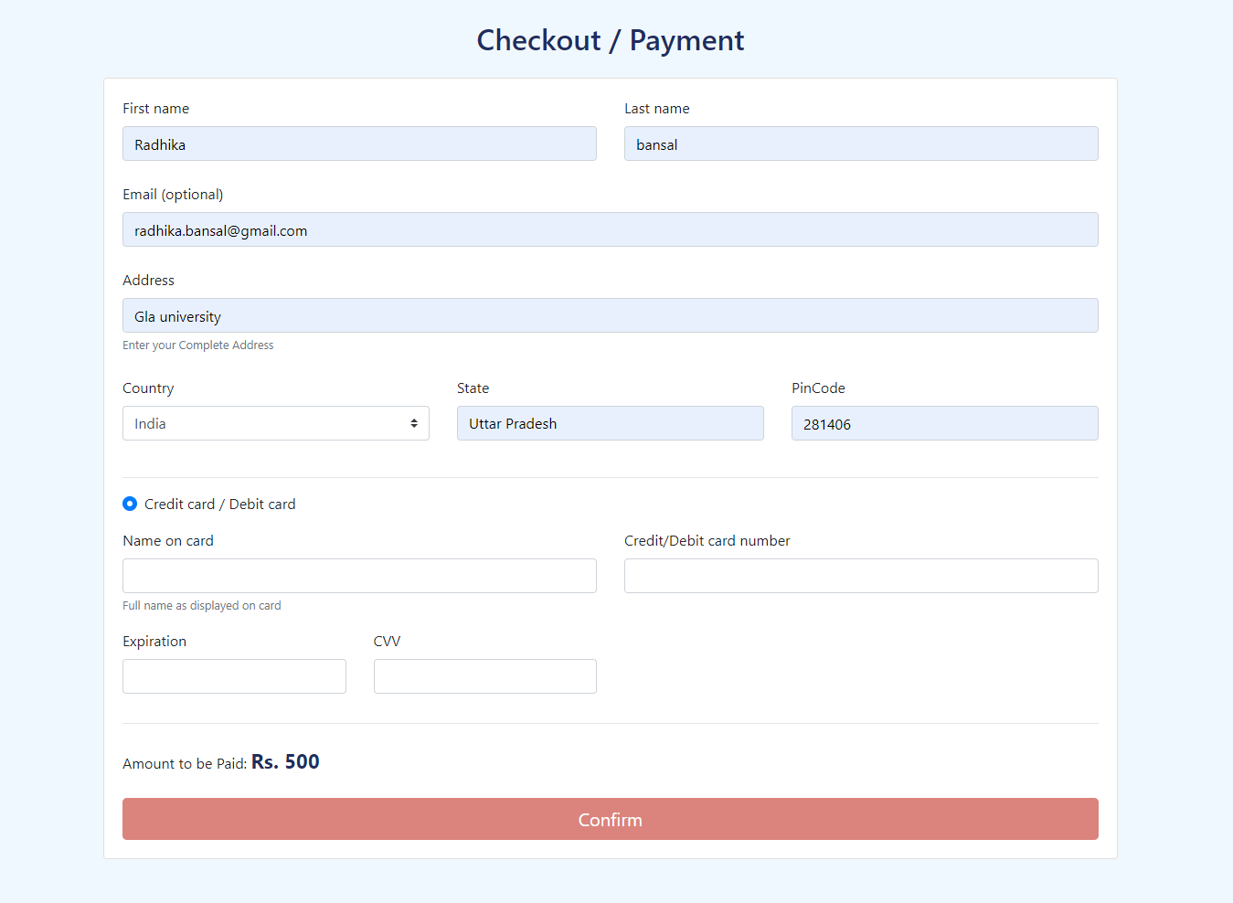
Checkout Page
This page includes a form to get all the details of the user like their name, their shipping address, their billing mode, their card details etc.

Slide 20
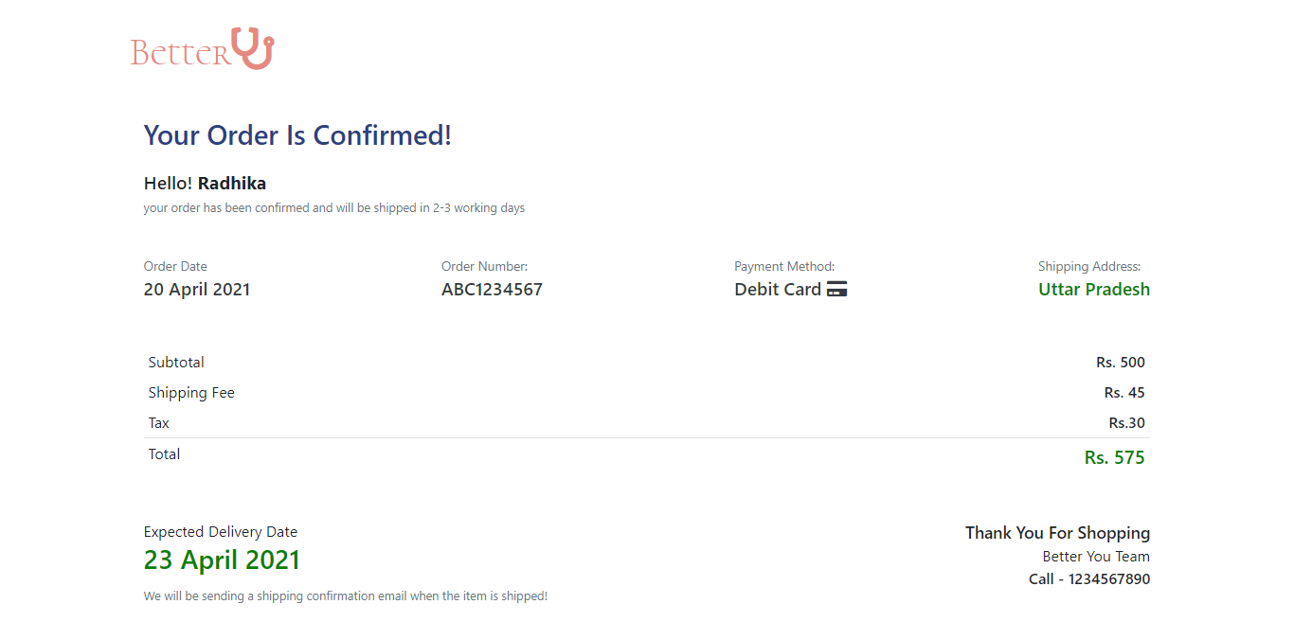
Order Confirmation Page
This page shows the confirmation message to the user with its name popping on the screen and the required details of the user fetched from the checkout form.

Slide 21
Link for the Website Code: https://github.com/nidhijaincs18/BetterYou
Link for the Live Website: https://nidhijaincs18.github.io/BetterYou/

Slide 22


